Slide 1



X
P e r f o r m a n c e
A N A L Y T I C S
BUSSINESS YEAR 2020-2023
KIMIA FARMA- BIG DATA ANALYTICS
PROJECT BASED INTERNSHIP
PRESENTED BY : DWI AJENG ROSMAYA
PAGE 01

Slide 2





ABOUT ME
I am a Mathematics graduate from UIN Maulana Malik Ibrahim Malang with a strong interest in data, including data analysis, data entry, and administration. As a data enthusiast, I continuously hone my skills through various courses and internship experiences to understand and process data effectively using different data visualization tools such as Tableau and Google Looker Studio. With strong analytical skills and attention to detail, I am committed to delivering accurate and valuable data-driven solutions.
PROJECT BASED INTERNSHIP
082233023717
https://www.linkedin.com/in/dwi-ajeng-rosmaya/
dwirosmaya@gmail.com
PAGE 04

Slide 3

ABOUT COMPANY
PT Kimia Farma Tbk. is a leading pharmaceutical company in Indonesia, specializing in the manufacturing, distribution, and sales of medicines and other healthcare products. Established in 1817, the company has a long-standing history in Indonesia’s pharmaceutical industry. As part of a state-owned enterprise (BUMN) group, Kimia Farma is committed to improving public health across the country.
Over the years, PT Kimia Farma Tbk has expanded into an integrated healthcare company in Indonesia. This growth is supported by its involvement in pharmaceutical manufacturing, research and development, distribution and trade, marketing, retail pharmacies, clinical laboratories, and healthcare clinics. The company’s pharmaceutical production includes chemical drugs, formulations, and herbal medicines, divided into six production lines: ethical drugs, over-the-counter medicines, generics, narcotics, licensed products, and raw materials. Kimia Farma accommodates almost all therapeutic classes, offering more than 385 products that are distributed nationwide and exported to several countries through its distribution network or partners. As part of its corporate social responsibility, Kimia Farma remains committed to ensuring a steady supply of generic medicines to the market.
PROJECT BASED INTERNSHIP
Source: https://www.kimiafarma.co.id/
PAGE 04

Slide 4


OVERVIEW
Designing a Business Performance Analytics Dashboard for 2020-2023. This dashboard will make it easier to evaluate Kimia Farma's business performance from 2020 to 2023, including branch performance, product analysis, sales performance, transaction and seasonal patterns, and performance based on location
Gain insights from various business performance aspects that serve as case studies in this project.
STUDY CASE
GOALS
There are 4 datasets used, that is:
kf_final_transaction.csv
kf_inventory.csv
kf_kantor_cabang.csv
kf_product.csv
DATA SET
TOOLS
PROJECT BASED INTERNSHIP
PAGE 09

Slide 5
PROJECT
PORTOFLIO
As a Big Data Analytics Intern at Kimia Farma, the tasks I carried out involved a series of challenges that required a deep understanding of data and analytical skills. One of my main projects was evaluating Kimia Farma's business performance from 2020 to 2023. Here are the tasks I performed:
Importing Data Set To Big Query
Creating analysis table
Creating dashboard performance analysis
PROJECT BASED INTERNSHIP
PROJECT EXPLANATION here
PAGE 08

Slide 6
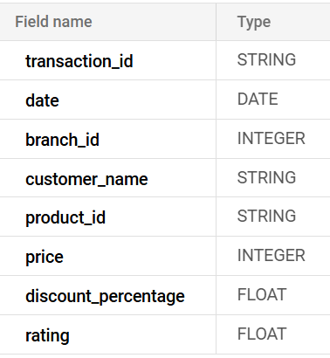
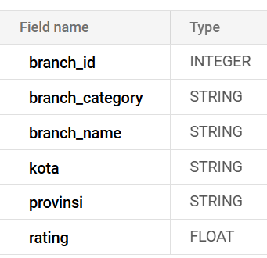
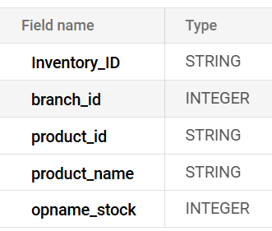
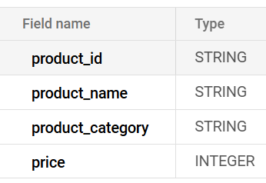
IMPORTING DATASET TO BIGQUERY
Steps:
Go to Google Cloud Console
Select Big Query
Select the dataset that was make before
Click Create Table button
In the source section, choose the data source, upload for a local file
Select file and choose the dataset and table name
Configure the schema and click create table
kf_final_transaction
kf_kantor_cabang
kf_inventory
kf_product
PROJECT BASED INTERNSHIP
PAGE 05

Slide 7
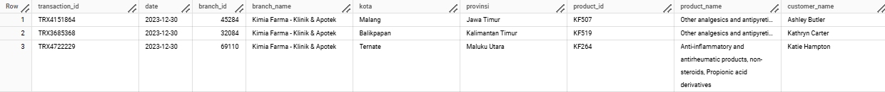
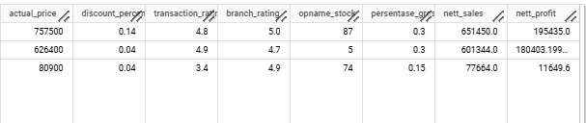
TABEL ANALISA
In this task, an analysis table is created based on the aggregation results from the four previously imported tables. The following are the mandatory columns in the table that is transaction_id, date, branch_id, branch_name, city, province, branch_rating, customer_name, product_id, product_name, actual_price, discount_percentage,
persentase_gross_laba:, based on the following conditions: ■ Price ≤ Rp 50,000 → 10% profit ■ Price > Rp 50,000 - 100,000 → 15% profit ■ Price > Rp 100,000 - 300,000 → 20% profit ■ Price > Rp 300,000 - 500,000 → 25% profit ■ Price > Rp 500,000 → 30% profit
nett_sales, nett_profit, transaction_rating and additional column that is opname_stock
PREVIEW
PROJECT BASED INTERNSHIP
PAGE 03

Slide 8
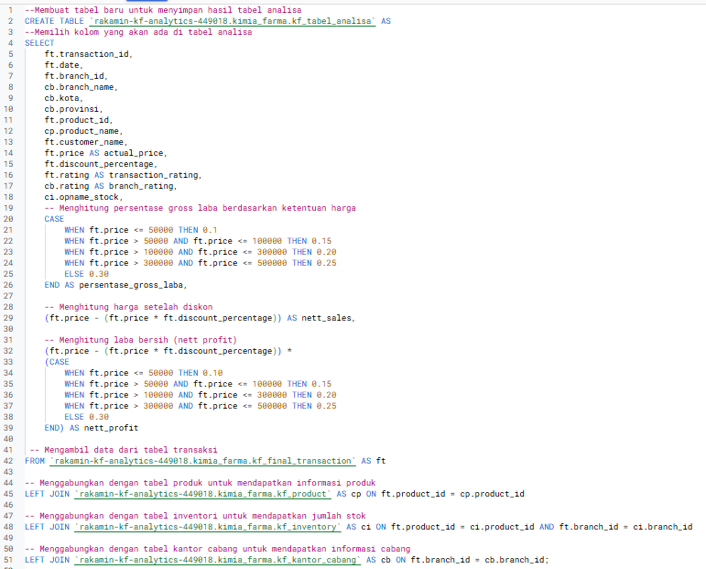
BIGQUERY
SYNTAX
PROJECT BASED INTERNSHIP
GITHUB : here
PAGE 10

Slide 9
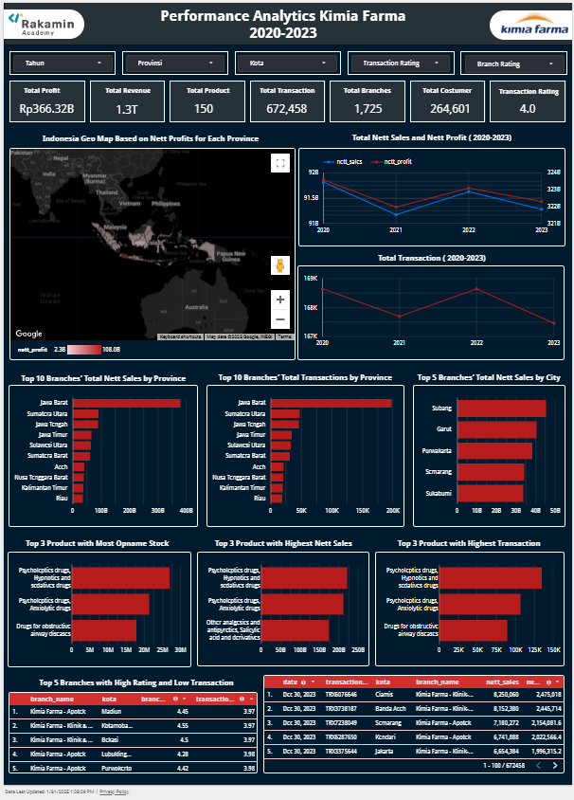
DASHBOARD PERFORMANCE ANALYTICS
Distribution of revenue and transactions with an average transaction rating of 4.0, indicating quite good customer satisfaction.
Time trends show fluctuations in net sales and transactions, which can be attributed to external factors and seasonality. This can be used as a timely promotional strategy to increase sales.
Analysis of transaction patterns shows that there are spikes in certain periods, which can be used for promotional strategies and stock management.
Branch performance shows that there are branches with high ratings but low transactions, which may require better marketing strategies
PROJECT BASED INTERNSHIP
Dashboard details here
PAGE 06

Slide 10
X
THANK
YOU
PROJECT BASED INTERNSHIP
PAGE 07

